Slide 1

GenerativeAI and Its Applications
Unit 1
(UE23CS342BA4)
LLM basics and Evolution
Dr. Pooja Agarwal
Dept. of CSE, PES University, Bangalore

Slide 2

Generative AI and its Applications
LLM basics and Evolution

Slide 3
GenerativeAI and Its Applications
Acknowledgement
The slides are prepared from various resources from the Universities from abroad and India. Also, some material is taken from reliable resources from internet throughout this course.

Slide 4
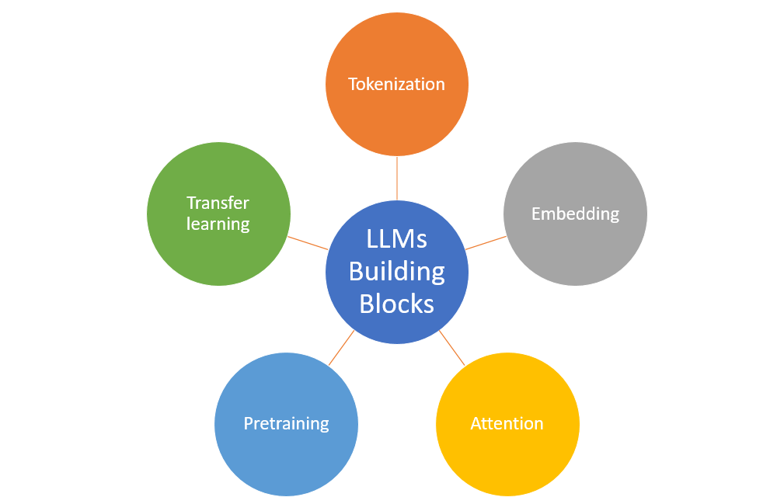
GenerativeAI and Its Applications
Key Building Blocks of LLMs
Large Language Models (LLMs) are composed of several key building blocks that enable them to efficiently process and understand natural language data.

Slide 5
GenerativeAI and Its Applications
Foundations of ML(Artificial Intelligence Paradigm)

Slide 6
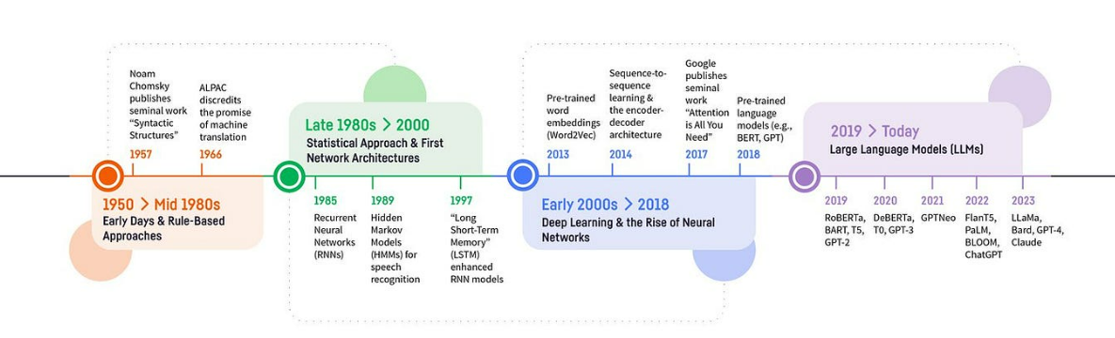
GenerativeAI and Its Applications
Brief History of NLP (WHEN and WHAT)
Artificial Intelligence (AI) is the umbrella field whose goal is to build machines that exhibit intelligent behavior.

Slide 7

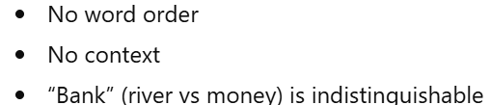
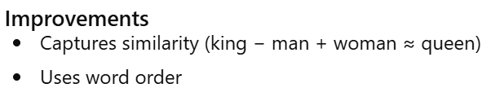
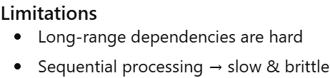
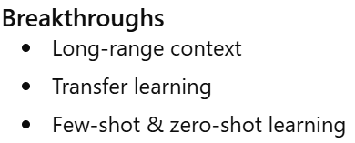
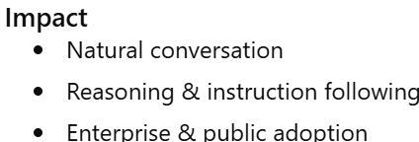
GenerativeAI and Its Applications
Brief History of NLP (WHY and HOW)
Human tech-era analogy inspired by Rongyao Huang:
Prehistory: NN-free NLP
Bag of words (Harris, 1954)
TF-IDF (Salton, 1983)
Topic models, e.g., LDA (Blei, Ng & Jordan, 2003) Latent Dirichlet Allocation: A generative statistical model used in natural language processing and topic modeling to classify text into topics.
Bronze Age: language embeddings & deep learning
word2vec (Mikolov et al., 2013)
DNNs (e.g., RNNs, LSTMs, GRUs) map embedding → outcome
Iron Age: LLMs with attention
Transformer (Vaswani et al., 2017)
BERT (Devlin et al., 2018), T5 (Raffel et al., 2020), GPT-3 (Brown et al., 2020)
Industrial Revolution: RLHF
InstructGPT (Ouyang et al., Mar 2022), ChatGPT (OpenAI, Nov 2022)
GPT-4 (OpenAI, Mar 2023), Anthropic, Cohere

Slide 8
GenerativeAI and Its Applications
Large Language Models (LLMs)
Large Language Models (LLMs) are machine learning models trained on vast amount of textual data to generate and understand human-like language.
These models can perform a wide range of natural language processing tasks from text generation to sentiment analysis and summarization.
Notes:
Encoder: Extracts features from an input sequence.
Decoder: Uses the features to produce an output sequence (e.g., translation)

Slide 9
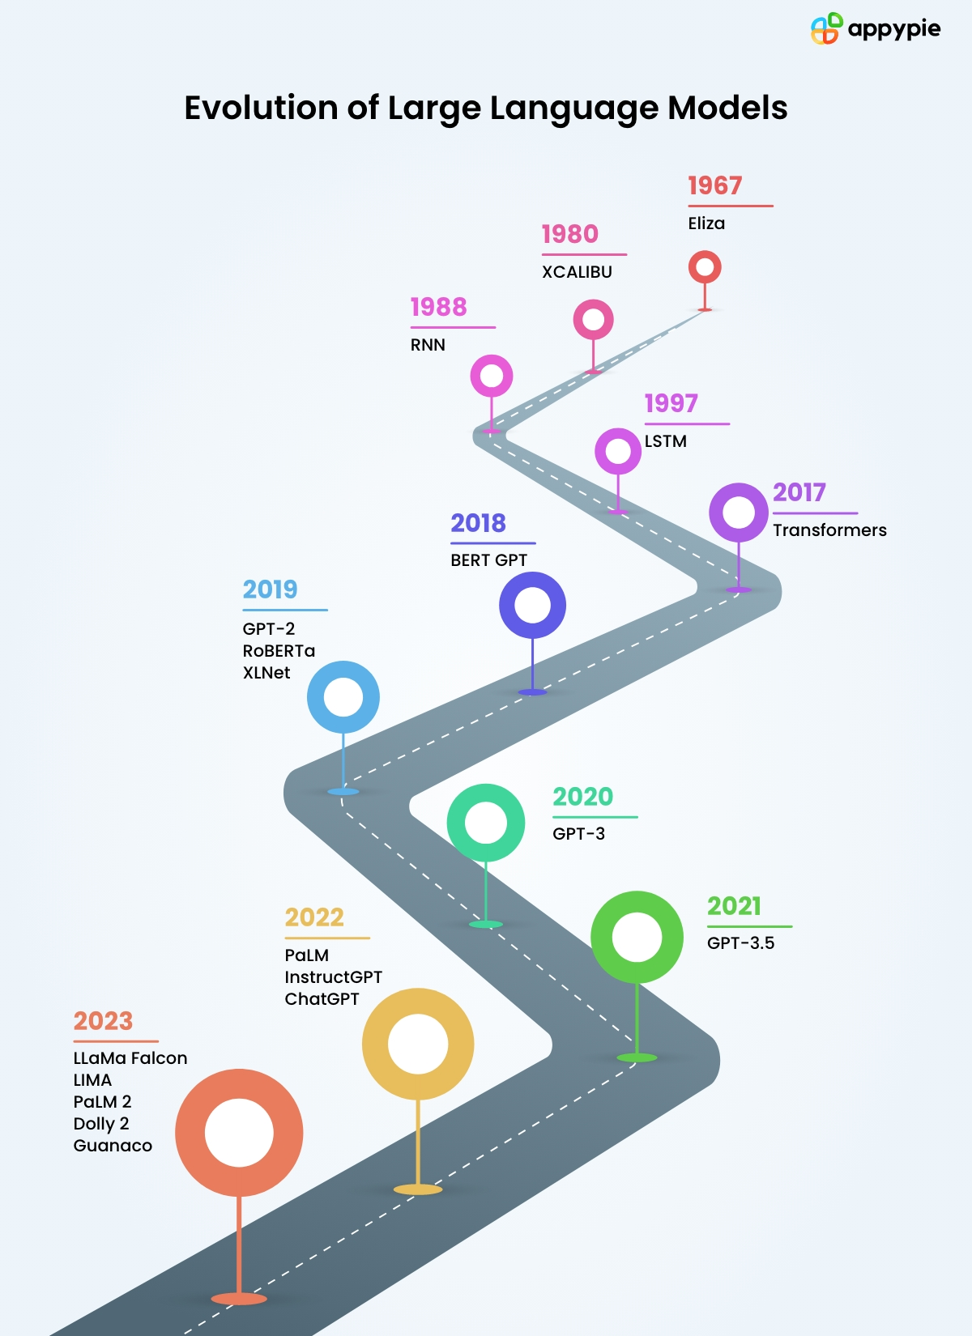
GenerativeAI and Its Applications
Evolution of LLMs
Rule-Based Language Models (1950-1960s)
Statistical Language Processing (1990s- early 2000s)
N-gram Models (1990s- early 2000s)
Neural Networks and the Rise of LLMs (The Late 2000s - onward)
Sequence-to-Sequence Models (2014 - onward)
BERT and Pre-trained Models (2018 - onward)
GPT Series (2019 - onward): Scaling up and Generative Power
GPT-3: The Megamodel (2020 - onward)
GPT-4 (2023): Multimodal Large Language Model

Slide 10
GenerativeAI and Its Applications
LLM Basic and Evolution
Simple timeline which led to LLMs as we see them today
1997: Introduction of Long Short-Term Memory (LSTM) networks (Learn More)
2010: Stanford's CoreNLP suite for sentiment analysis
2017: Transformer architecture introduction (Popular paper - Attention Is All You Need)
2018: GPT-1 (117M parameters) (Learn More)
2019: GPT-2 (1.5B parameters) (Learn More)
2020: GPT-3 (175B parameters) (Learn More)
2022: ChatGPT released to general public
2023 - Early 2024: GPT-4o introduction (Multimodal llms era started)
Late 2024: GPT o1 and o3 announced and open source llms competing with SOTA models

Slide 11
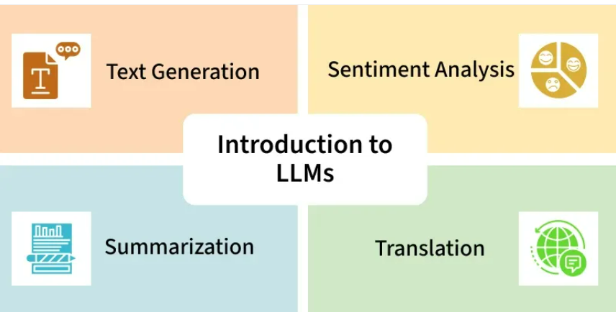
GenerativeAI and Its Applications
Introduction to LLMs
Notes:
Encoder: Extracts features from an input sequence.
Decoder: Uses the features to produce an output sequence (e.g., translation)

Slide 12
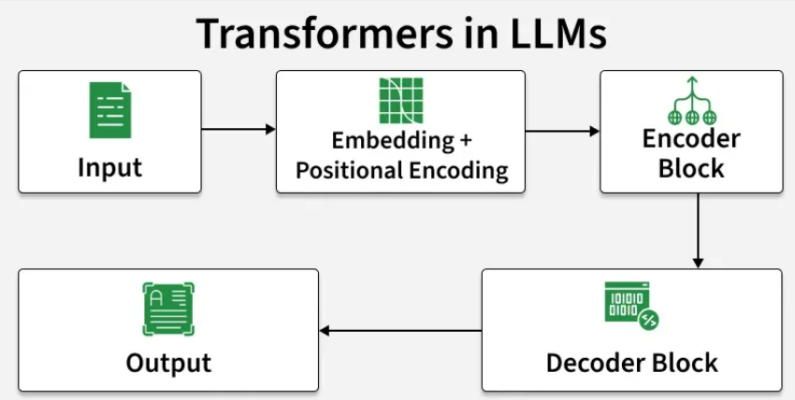
GenerativeAI and Its Applications
Transformers in LLM
Notes:
Encoder: Extracts features from an input sequence.
Decoder: Uses the features to produce an output sequence (e.g., translation)

Slide 13
GenerativeAI and Its Applications
Two Stage Process of Building an LLM
The process of creating an LLM involves two main stages: pretraining and finetuning.
1. Pretraining
Definition:
Pretraining is the initial phase where the model is trained on a large, diverse corpus of text data (referred to as "raw text").
The goal is to develop a broad understanding of language by predicting the next word in a sequence (next-word prediction).
Dataset:
The dataset used for pretraining is typically massive and diverse, containing billions of tokens from books, articles, websites, and other text sources.
Filtering may be applied to remove irrelevant or low-quality data (e.g., formatting characters, unknown languages).
Output:
The result of pretraining is a base model or foundation model that has a general understanding of language.
Example: GPT-3, which can perform text completion and has limited few-shot learning capabilities.
References:
Book: Build a Large Language Model (From Scratch)

Slide 14
GenerativeAI and Its Applications
Two Stage Process of Building an LLM
The process of creating an LLM involves two main stages: pretraining and finetuning.
2. Finetuning
Definition:
Finetuning is the process of refining the pretrained model on a smaller, labeled dataset that is specific to a particular task or domain.
This step adapts the general-purpose model to perform well on specific tasks.
Types of Finetuning:
Instruction-Finetuning:
The labeled dataset consists of instruction-answer pairs.
Example: Training the model to translate text by providing queries and their corresponding translations.
Classification Finetuning:
The labeled dataset consists of text and associated class labels.
Example: Training the model to classify emails as spam or non-spam.
Output:
A specialized LLM that is optimized for a specific task or domain.
References:
Book: Build a Large Language Model (From Scratch)

Slide 15
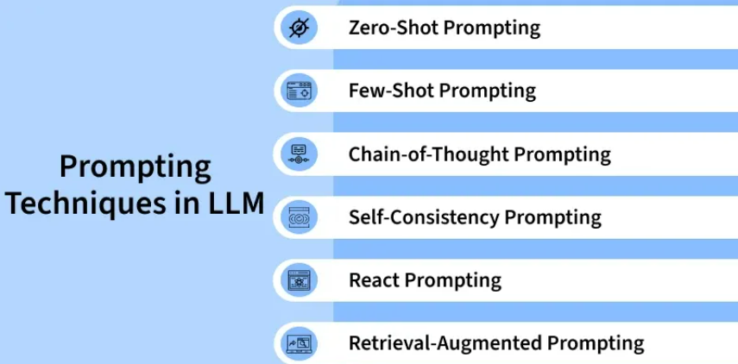
GenerativeAI and Its Applications
Prompting Techniques in LLM
Notes:
Encoder: Extracts features from an input sequence.
Decoder: Uses the features to produce an output sequence (e.g., translation)

Slide 16
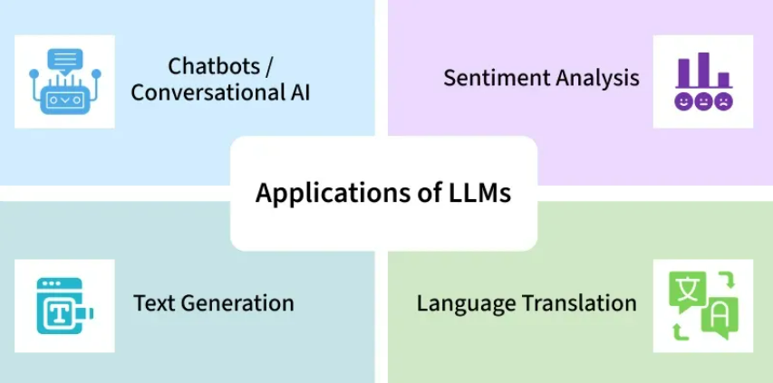
GenerativeAI and Its Applications
Applications of LLMs
Notes:
Encoder: Extracts features from an input sequence.
Decoder: Uses the features to produce an output sequence (e.g., translation)

Slide 17
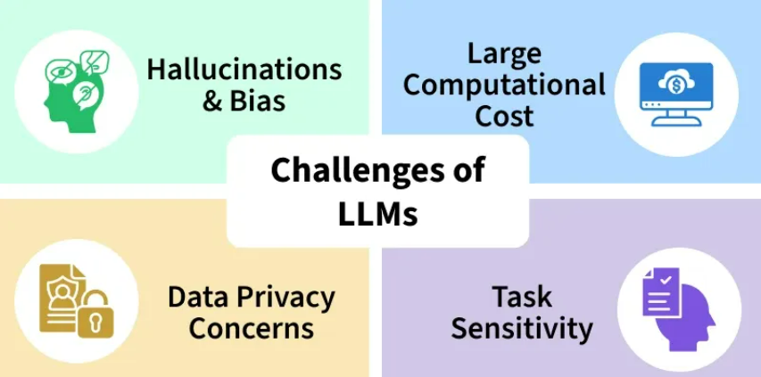
GenerativeAI and Its Applications
Challenges of LLMs
Notes:
Encoder: Extracts features from an input sequence.
Decoder: Uses the features to produce an output sequence (e.g., translation)

Slide 18
GenerativeAI and Its Applications
Transformers
Transformers are the foundational architecture behind most modern large language models that rely on attention mechanisms to process the entire sequence of the data simultaneously.
Notes:
Encoder: Extracts features from an input sequence.
Decoder: Uses the features to produce an output sequence (e.g., translation)

Slide 19
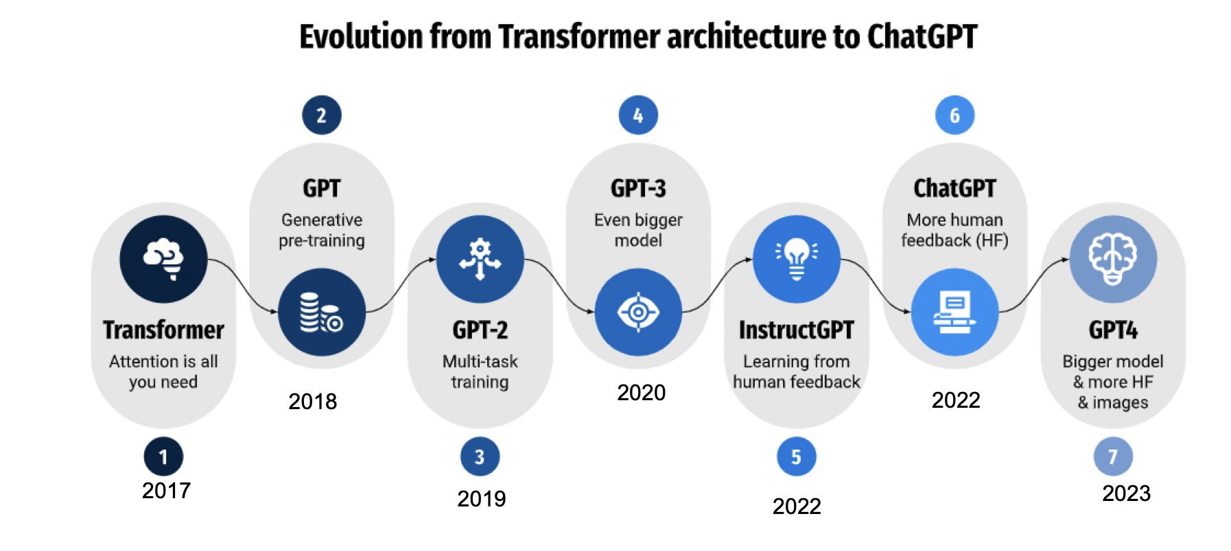
GenerativeAI and Its Applications
Evolution of Transformers
Source: Kocoń, Jan, Igor Cichecki, Oliwier Kaszyca, Mateusz Kochanek, Dominika Szydło, Joanna Baran, Julita Bielaniewicz et al. "ChatGPT: Jack of all trades, master of none." Information Fusion (2023): 101861.

Slide 20
GenerativeAI and Its Applications
Different Versions of GPT
S.No | Version | Model Architecture | Parameters | Training Data | Capabilities | Key Innovations
1 | GPT-1 | 12-layer transformer decoder | 117 million | BooksCorpus | Demonstrated fine-tuning on specific tasks | Established unsupervised pre-training followed by supervised fine-tuning
2 | GPT-2 | Up to 48-layer transformer decoder | 1.5 billion | WebText (8 million documents) | Strong zero-shot performance | Showed scaling effect with increased model size and data
3 | GPT-3 | 96-layer transformer decoder | 175 billion | Mixture (Common Crawl, WebText, Books, Wikipedia) | Impressive few-shot and zero-shot learning | Introduced in-context learning
4 | GPT-3.5 | Similar to GPT-3 with optimizations | ~175 billion | Updated and expanded datasets | Improved performance and reliability | Enhanced alignment with user intentions
5 | GPT-4 | More sophisticated and larger-scale architecture | Hundreds of billions to trillions | Vastly expanded and more diverse datasets | Superior performance across a broad range of tasks | Enhanced alignment techniques, increased robustness, better handling of complex queries
Notes:
nlp - ChatGPT's Architecture - Decoder Only? Or Encoder-Decoder? - Data Science Stack Exchange

Slide 21
Thank You

